Slide 1

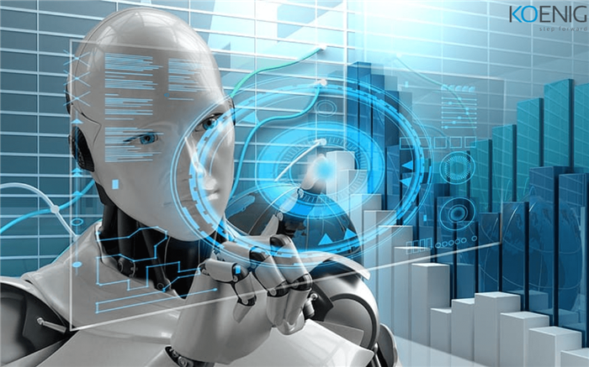
Module 1: Introduction to Artificial intelligence
What is AI, History of AI, Types of AI, Components of Intelligence, Agent and Environment, Informed Search Algorithms: Pure Heuristic, Best first, A*, AO* Algorithms.

Slide 2
What is Artificial Intelligence
Definition : From a layman’s view, artificial intelligence (AI), simply means
The intelligence demonstrated by machines that help them to mimic the actions of humans. AI simulates natural intelligence in machines that are programmed to learn from experiences, adjust to new inputs and perform human-like tasks
AI simulates natural intelligence in machines that are programmed to learn from experiences, adjust to new inputs and perform human-like tasks.

Slide 3
From a researcher’s view,
AI is a set of algorithms that generates results without having to be explicitly instructed to do so, thereby making machines capable of thinking and acting rationally and humanely.
How Does AI Work?
AI systems work effectively when fed with a large amount of labelled training data. This data is thoroughly analyzed to discover correlations and patterns.
For example, a Chabot fed with examples of text chats can learn to converse with humans in real-world applications.

Slide 4
AI programming focuses on three cognitive skills
1. Learning : AI programs focus on acquiring data and creating rules for turning that data into actionable information. Rules, also known as algorithms, provide step by-step instructions to complete a specific task.
2. Reasoning : The success of an AI program depends on choosing the right algorithm to reach the desired outcome.
3. Self-correction: AI programs are designed to continually enhance their algorithms to provide the most accurate results.

Slide 5
Case Study: Why is artificial intelligence important?
AI allows business organizations to gain insights into their operations that they may not have been previously aware of.
There are numerous tasks that AI-enabled machines can perform better than humans. This has acted as the driving force for exploring new business opportunities.
Example : Uber, one of the largest companies in the world, is utilizing sophisticated machine learning algorithms to predict when people would need a greater number of rides in a particular area so that the company can get drivers on the road before they are needed.

Slide 6
Advantages and Disadvantages of Artificial Intelligence
Advantages
1. Performs well on tasks that uses detailed data.
2. Takes less time to perform tasks that needs to process huge volumes of data.
3. Generates consistent and accurate results.
4. Can be used 24 X 7.
5. Optimizes tasks by better utilizing resources.
6. Automates complex processes.
7. Minimizes downtime by predicting maintenance needs.
8. Enables companies to produce new products having better quality and speed.

Slide 7
Advantages and Disadvantages of Artificial Intelligence
Disadvantages
1. Involves more cost.
2. Technical expertise required to develop and use AI applications.
3. Lack of trained professionals.
4. Incomplete or inaccurate data may result in disastrous results.
5. Lacks the capability to generalize tasks.

Slide 8
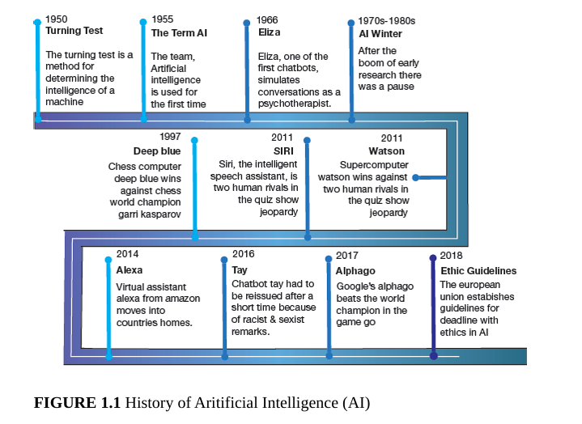
History of AI

Slide 9
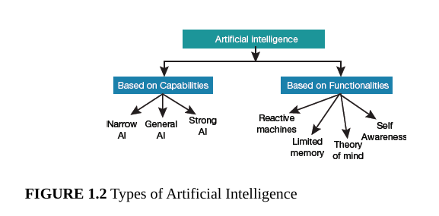
Types of AI

Slide 10
1. Weak AI or Narrow AI:
Narrow AI is a type of AI which is able to perform a dedicated task with intelligence. The most common and currently available AI is Narrow AI in the world of Artificial Intelligence.
Example: Apple Siris
2. General AI:
The idea behind the general AI to make such a system which could be smarter and think like a human by its own.
As systems with general AI are still under research, and it will take lots of efforts and time to develop such systems.

Slide 11
3. Strong AI/ Super AI:
Super AI is a level of Intelligence of Systems at which machines could surpass human intelligence, and can perform any task better than human with cognitive properties. It is an outcome of general AI.
Strong AI, also known as artificial general intelligence or artificial super intelligence (ASI) or superintelligence, makes full attempt to resemble the human brain.
It utilizes cognitive skills and fuzzy logic to perform tasks for which it had not been trained earlier. Such a system needs capability for visual perception, speech recognition, decision-making and translations between languages.

Slide 12
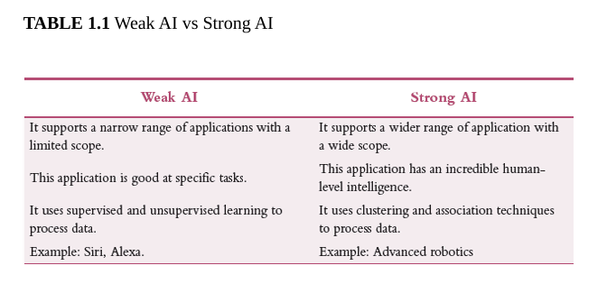

Slide 13
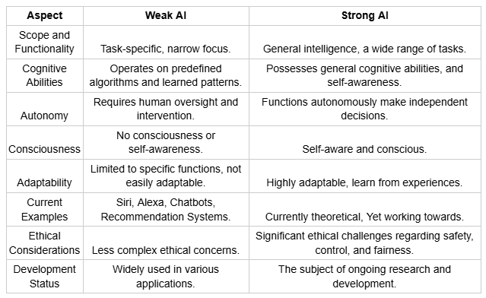

Slide 14
1. Reactive Machines:
Reactive machines are very basic machines with no memory to store and thus use past experiences to determine future actions.
The AI system sees the pieces on a chess board and responds without referring to any of its prior experiences.
Since it lacks capabilities to store past experiences, a reactive machine cannot improve with practice
Reactive machines can perform only a limited number of specialized tasks. Such machines are more trustworthy and reliable as they react the same way to the same stimuli every time.
Examples :
  Deep Blue could only identify the pieces on a chess board and compute its next move based on the rules of chess and the present positions.
  Google’s AlphaGo is another example of a game-playing reactive machine.

Slide 15
2. Limited Memory :
Limited memory machines retain data but only for a short period of time and can use it only for a limited time.
They cannot keep adding data permanently to a library of their experiences.
Such systems are usually used in autonomous vehicles since they need not store data that can help them navigate roads.
There are three major machine learning models that applies limited memory artificial intelligence
  Reinforcement learning
  Long Short-term Memory (LSTM)
  Evolutionary Generative Adversarial Networks (E-GAN)

Slide 16
3. Theory of Mind :
The theory of mind focuses on imitating the human brain.
For this, it forms representations about the world, starting from thoughts, emotions and memories.
However, such systems are only theoretical as of now but they may become reality very soon.
These machines must understand thoughts and emotions that affect the behaviour of one’s self.
Theory of Mind machines make decisions keeping in view the feelings experienced through self-reflection and determination.

Slide 17
4. Self-Awareness
Self-awareness in machines enable them to possess human-level consciousness, understand the current state—its own existence in the world and use that information to deduce others feelings.
Self-AI systems will be able to understand what others may need.
They could interpret user’s feelings by learning not only what they communicate to them but also how they communicate it.
Knowledge imbibed by researchers and its learning of the conscious context will help them to respond to an event.

Slide 18

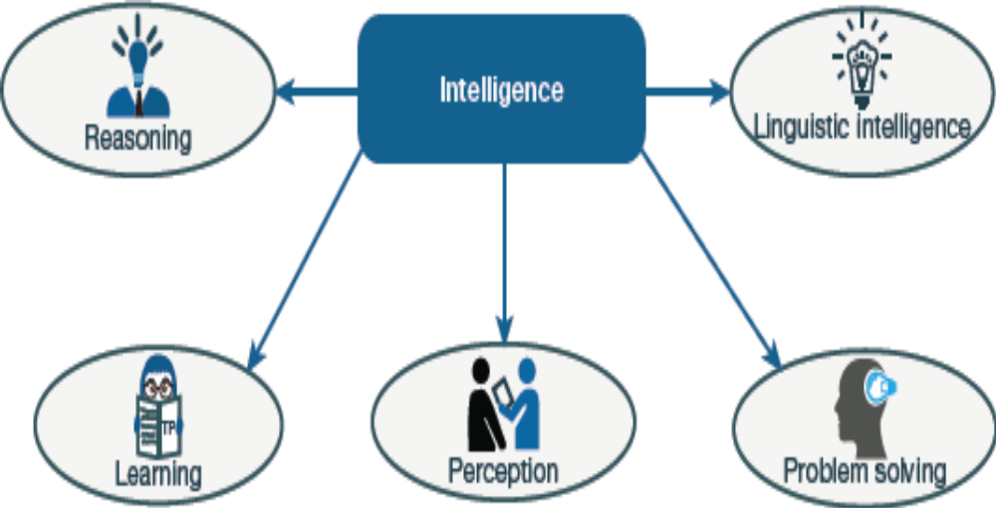
Components of Intelligence

Slide 19
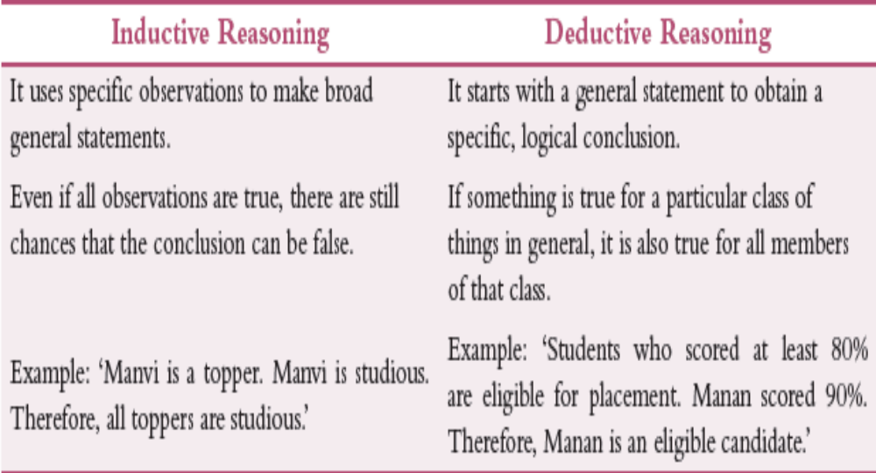
1. Reasoning: It is the set of processes that is used in making decisions and prediction.
There are two types of reasoning—inductive and deductive.

Slide 20
2. Learning: It is a process of gaining knowledge or skill by studying, practicing, being taught or experiencing something. Learning is an ability that is possessed by humans, animals and AI-enabled systems to improve the awareness of the subjects of the study.
Learning can be categorized as follows:
1. Auditory learning 6. Relational learning
2. Episodic learning 7. Spatial learning
3. Motor learning 8. Stimulus-response learning
4. Observational learning
5. Perceptual learning

Slide 21
3. Problem Solving: It is the process in which one tries to find the desired solution in the present situation by following the path which is blocked by known or unknown hurdles. Problem solving uses decision-making to select the best suitable alternative to reach the desired goal.
4. Perception: It is the process of acquiring, interpreting, selecting and organizing sensory information. While humans use sensory organs to perceive their environment, AI systems use data acquired by the sensors to do the same.
5. Linguistic Intelligence: It is used in in interpersonal communication and defines one’s ability to use, comprehend, speak and write the verbal and written language.

Slide 22
Agent and Environment
Artificial intelligence is all about studying rational agents, which may include anything that makes decisions. For example, a person, firm, machine or software that performs action(s) with the best outcome after considering past and current percepts at a given instance are examples of agents.
These agents work in their environment and may interact with other agents in that environment. Thus, we can say that an AI system comprises an agent and its environment.

Slide 23
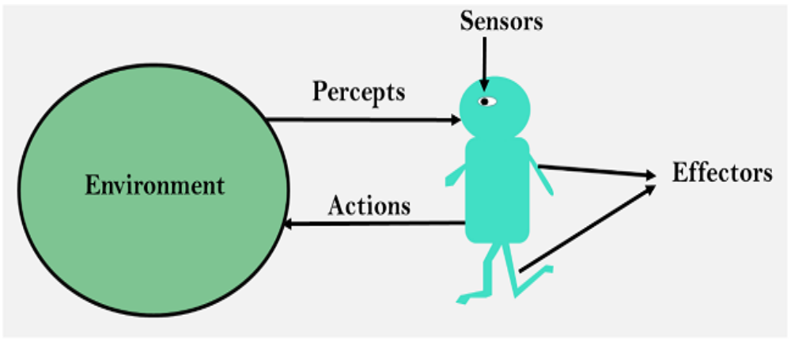
What is an Agent and Environment
An agent can be anything that perceive its environment through sensors and act upon that environment through actuators.
The environment is the surrounding, external context – physical or digital with which the agent interacts, providing feedbacks through data or state changes.

Slide 24
The different types of agents in an AI system include the following:
1. Human agent: A human agent has sensory organs (like eyes, ears, nose, tongue and skin) that acts as sensors, and other organs such as hands, legs, mouth as effectors for taking actions.
2. Robotic agent: A robotic agent uses cameras and infrared range finders as sensors, and various motors and actuators as effectors.
3. Software agent: Such an agent uses bit strings as its programs and actions

Slide 25
Key Terminology
Performance Measure of Agent: This criteria helps to determine how successful an agent is.
Behavior of Agent: It is an action performed by an agent after any receiving a certain percept.
Percept: These are perceptual inputs given to an agent at a specific instance.
Percept Sequence: This is a list of all percepts received by an agent till date.
Agent Function: This is a map from the precept sequence to an action

Slide 26
Rationality
Rationality is a feature that inculcates a sense of responsibility, sensibility and judgment.
It empowers the agent to perform expected actions after perceiving.
The agent must perform all the actions to maximize its performance measure with respect to the percept sequence and the knowledge base that it has.
Rationality of an agent depends on the following:
Agent’s performance measure that gives the degree of success.
Agent’s percept sequence received so far.
Agent’s prior knowledge about the environment.
Agent’s actions that can be performed

Slide 27
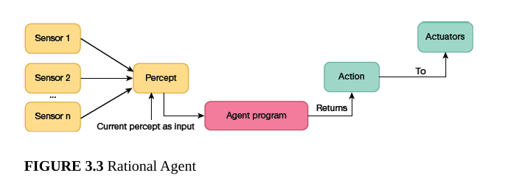
Structure of Intelligent Agents
The structure of an intelligent agent can be given as,
Agent = Architecture + Agent Program
where architecture is the machinery on which an agent works, and agent program is an implementation of an agent function.

Slide 28
Types of AI Agents
Simple Reflex Agent
Model-based reflex agent
Goal-based agents
Utility-based agent
Learning agent

Slide 29
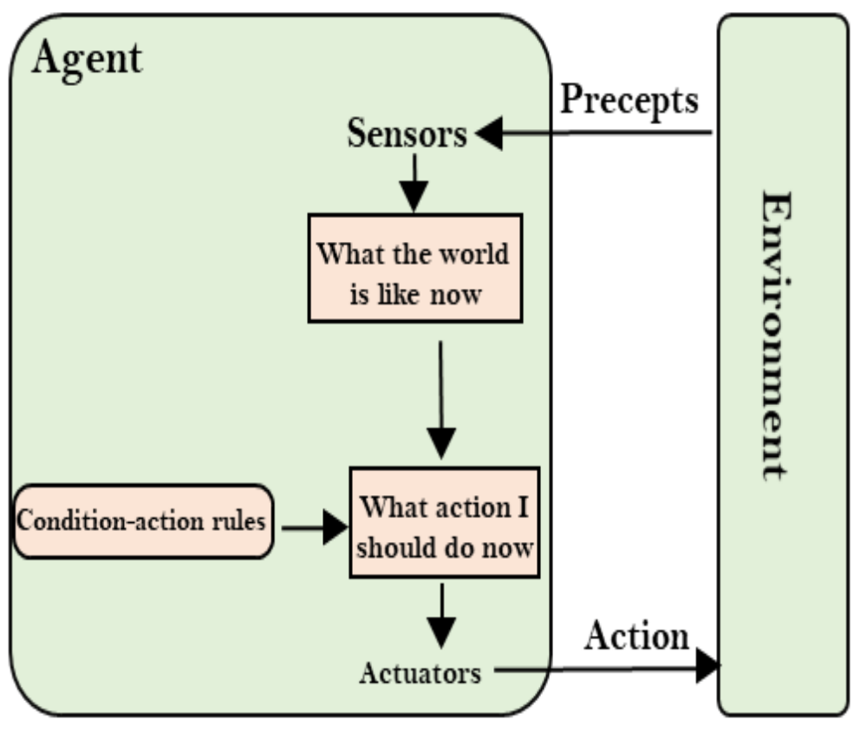
1. Simple Reflex Agent
The Simple reflex agents are the simplest agents.
These agents take decisions on the basis of the current percepts and ignore the rest of the percept history.
These agents only succeed in the fully observable environment.
The Simple reflex agent does not consider any part of percepts history during their decision and action process.

Slide 30
They work using condition-action rule that maps a state (condition) to an action. If the condition is true, then the action is taken, else not.
The problem with a simple reflex agent is that they succeed only when the environment is fully observable. If the environment is partially observable, then the agent may get stuck in infinite loops.
Examples :
  Vacuum cleaner sucking dirt upon detection.
  An Automatic door opening when motion is detection.

Slide 31
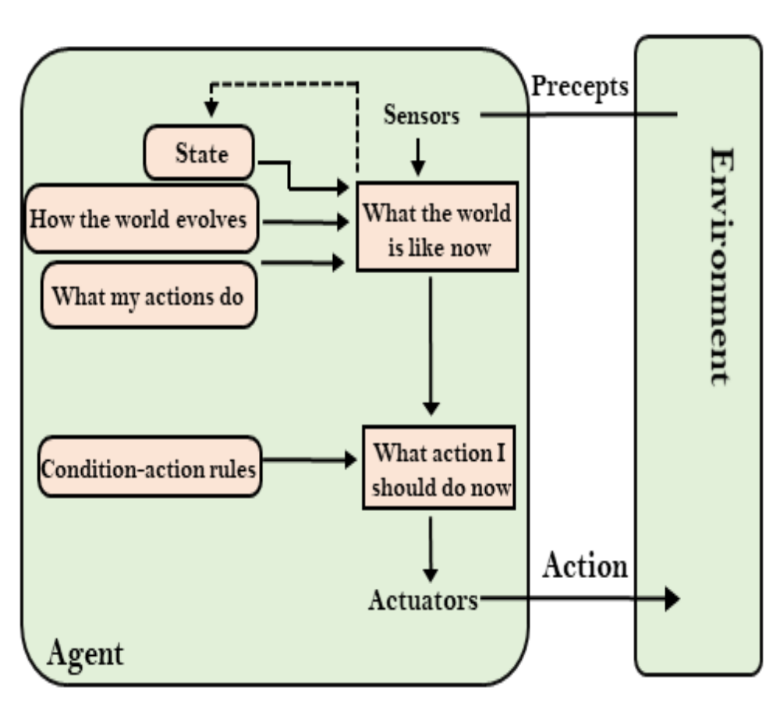
2. Model-based reflex agent
The Model-based agent can work in a partially observable environment, and track the situation.
A model-based agent has two important factors:
  Model: It is knowledge about "how things happen in the
world," so it is called a Model-based agent.
  Internal State: represents unobserved aspects of the current state depending on percept history.

Slide 32
How They Work:
UPDATE-STATE: It updates its internal model using current sensors (percepts), the previous state, and knowledge of how the world evolves.
RULE-MATCH: It checks this updated state against a set of rules (e.g., "If car is too close, brake").
Action: The action is chosen based on the internal state, not just current perception.
Example : Autonomous Vehicle/Self-Driving Car: When a car in front disappears into a blind spot, the model-based agent remembers its existence and predicted speed. It uses sensors (camera/lidar) to update its internal model of surroundings to decide when to change lanes, brake, or accelerate based on past and current data.

Slide 33
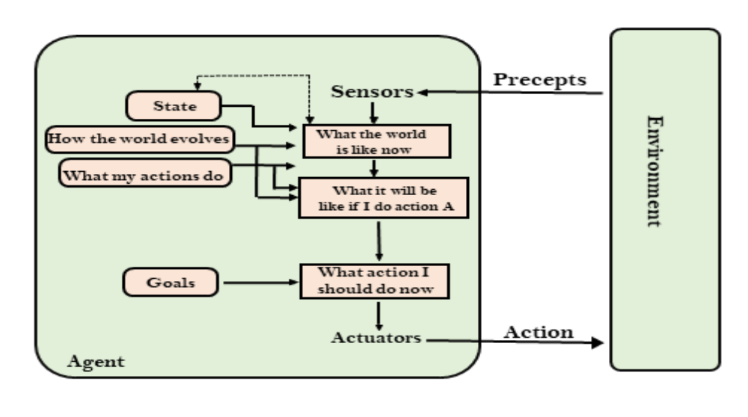
3. Goal-based agents

Slide 34
A goal-based agent is an AI system that acts to achieve specific objectives by planning, evaluating, and selecting the best actions to reach a desired future state, rather than just reacting to immediate stimuli.
The knowledge of the current state environment is not always sufficient to decide for an agent to what to do.
The agent needs to know its goal which describes desirable situations.
Goal-based agents expand the capabilities of the model-based agent by having the "goal" information.
GPS Navigation Systems (e.g., Google Maps): The agent takes the goal destination and maps multiple routes, selecting the most efficient path and updating it in real-time if conditions (e.g., traffic, road closures) change.
Personal Assistants (Siri/Alexa): These agents take a voice command (e.g., "set a timer for 10 minutes") as a goal and perform a sequence of actions to fulfill it.
AI in Games (NPCs): Non-player characters use goal-based reasoning to adopt strategies (e.g., "find cover," "attack player") to achieve a,goal like winning the game, rather than simply reacting to the player's presence

Slide 35
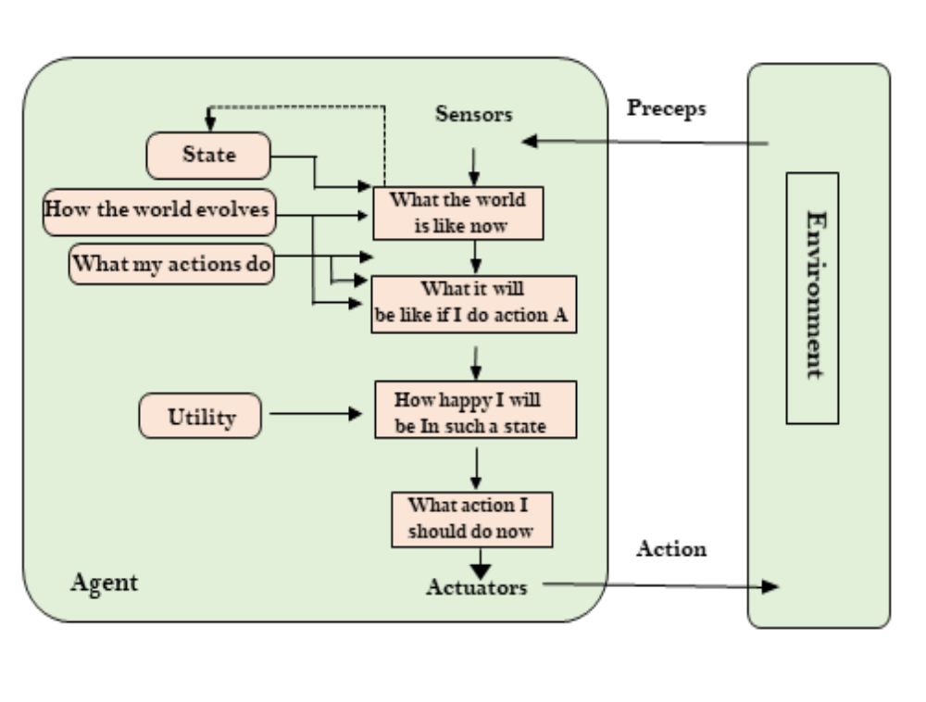
4. Utility-based agents

Slide 36
These agents are similar to the goal-based agent but provide an
extra component of utility measurement which makes them
different by providing a measure of success at a given state.
Utility-based agent act based not only goals but also the best
way to achieve the goal.

Slide 37
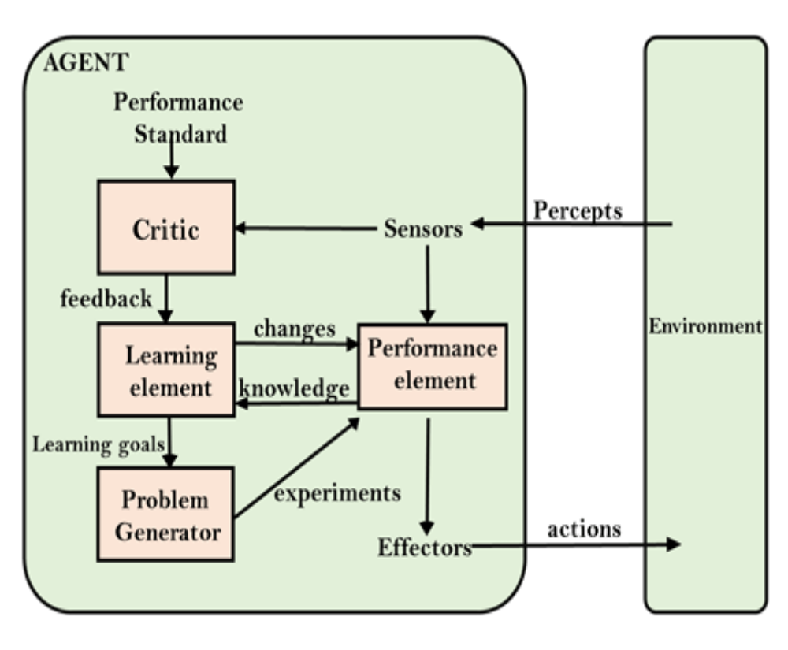
5. Learning Agents

Slide 38
A learning agent in AI is the type of agent which can learn from
its past experiences, or it has learning capabilities.
It starts to act with basic knowledge and then able to act and
adapt automatically through learning.

Slide 39
Agent Environment in AI
An environment is everything in the world which surrounds the
agent, but it is not a part of an agent itself. An environment can be
described as a situation in which an agent is present.

Slide 40
Features of Environment
1. Fully observable vs Partially Observable
2. Static vs Dynamic
3. Discrete vs Continuous
4. Deterministic vs Stochastic
5. Single-agent vs Multi-agent
6. Episodic vs sequential
7. Known vs Unknown
8. Accessible vs Inaccessible

Slide 41
Search Algorithms in Artificial Intelligence
Search algorithms are one of the most important areas of Artificial Intelligence.
This topic will explain all about the search algorithms in AI.
A search problem consists of the following:
1. State space is the set of all possible states that can be attained by an agent.
2. Start state is the state from where the searching is done.
3. Goal test is a function that checks if the current state is the goal state or not.
4. Solution to a search problem is a sequence of actions (also known as plan) that transforms the start state to the goal state. This plan is realized using search algorithms

Slide 42
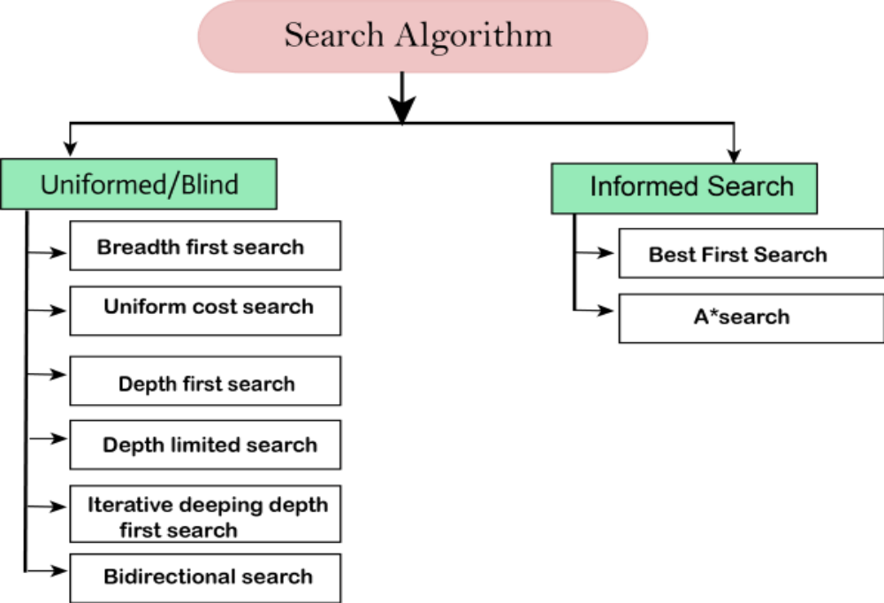
Types of search algorithms

Slide 43
Uninformed Search Algorithms
A uninformed search, also known as a blind search algorithm, has no additional information about the goal state other than the one provided in the problem definition.
In such algorithms, the machine blindly follows the technique irrespective of whether it is right or wrong, efficient or inefficient.

Slide 44
Informed Search Algorithms
Informed search algorithm, as the name suggests, contains some information about how far we are from the goal, cost of the path, how to reach the goal, etc.
This knowledge helps agents to explore less to the search space and reach the goal node more efficiently.
The informed search algorithm which is extensively used in a large space is also known as heuristic search as it uses a heuristic function.
The heuristic function takes the current state of the agent as its input and estimates how close the agent is from the goal.

Slide 45
A heuristic function h(n), calculates the cost of an optimal path between the pair of states.
The value of the heuristic function is always positive.
We can write, h(n) <= h*(n)
where h(n) is heuristic cost, and h*(n) is the estimated cost.
This means that the heuristic cost should be less than or equal to the estimated cost.

Slide 46
Pure Heuristic Search
Heuristic search is the simplest form of heuristic search algorithms that expands nodes based on their heuristic value h(n). The algorithm maintains two lists—OPEN and CLOSED.
All nodes that have already been expanded are placed in the CLOSED list, while others that have not been expanded are in the OPEN list.
Two important informed search algorithms
  Best first search algorithm (greedy search)
  A* search algorithm.

Slide 47
1. Best-first Search Algorithm:
Best-first search algorithm always selects the path which appears best at that moment.
It is the combination of depth-first search and breadth-first search algorithms. It uses the heuristic function and search.
Best-first search allows us to take the advantages of both algorithms.

Slide 48
Best first search algorithm:
Step 1: Place the starting node into the OPEN list.
Step 2: If the OPEN list is empty, Stop and return failure.
Step 3: Remove the node n, from the OPEN list which has the lowest value of h(n), and places it in the CLOSED list.
Step 4: Expand the node n, and generate the successors of node n.
Step 5: Check each successor of node n, and find whether any node is a goal node or not. If any successor node is goal node, then return success and terminate the search, else proceed to

Slide 49
Step 6: For each successor node, algorithm checks for evaluation function f(n), and then check if the node has been in either OPEN or CLOSED list. If the node has not been in both list, then add it to the OPEN list.
Step 7: Return to Step 2.

Slide 50
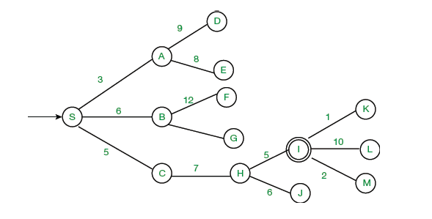
Example :Apply greedy best first search algorithm on the graph given below to reach node I from node S.

Slide 51
2. A* Search Algorithm:
A* search is the most commonly known form of best-first search. It uses heuristic function h(n), and cost to reach the node n from the start state g(n).
A* search algorithm finds the shortest path through the search space using the heuristic
function.
In A* search algorithm, we use search heuristic as well as the cost to reach the node.
Hence we can combine both costs as following, and this sum is called
as a fitness number.

Slide 52
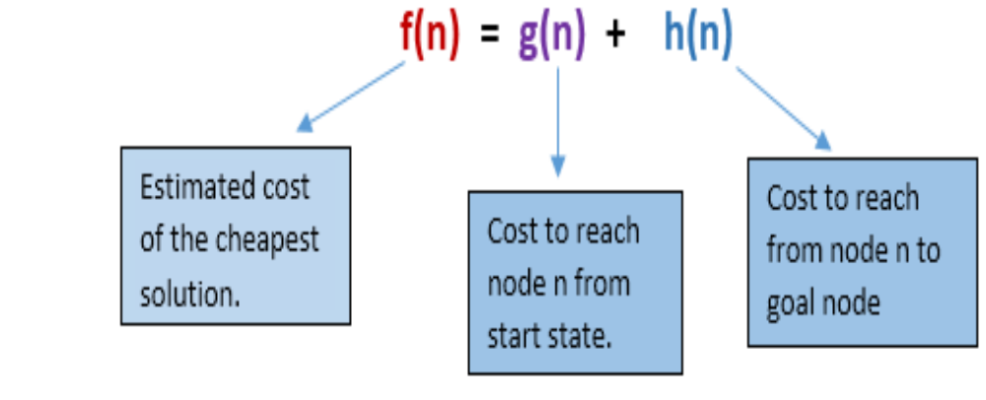

Slide 53
Algorithm of A* search:
Step1: Place the starting node in the OPEN list.
Step 2: Check if the OPEN list is empty or not, if the list is empty
then return failure and stops.
Step 3: Select the node from the OPEN list which has the smallest value of evaluation function (g+h), if node n is goal node then return success and stop, otherwise
Step 4: Expand node n and generate all of its successors, and put n into the closed list. For each successor n', check whether n' is already in the OPEN or CLOSED list, if not then compute evaluation function for n' and place into Open list.

Slide 54
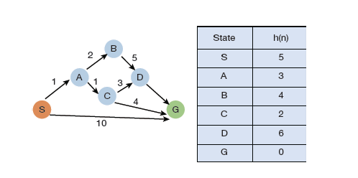
Step 5: Else if node n' is already in OPEN and CLOSED, then it should be attached to the back pointer which reflects the lowest g(n') value.
Step 6: Return to Step 2.
Example: Consider the graph given below and traverse it using the A* algorithm.

Slide 55
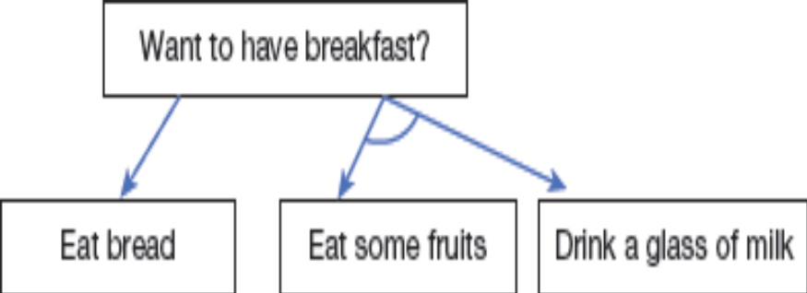
3. AO*Algorithm
AO* algorithm is based on problem decomposition in which a problem is
broken down problem into smaller pieces.
shows an AND-OR graph. It shows that if you want to have
breakfast then you can eat bread or have fruits and milk together. The arc
denotes AND condition.

Slide 56
Both A and AO algorithms are informed search techniques and use
heuristic values to solve the problem.

